Slide 1


Analyzing eCommerce Business Performance with SQL
Created by:
Hafidz Alawy
Hafidz.alawy54@gmail.com
www.linkedin.com/in/hafidz-alawy/
https://github.com/hafidzalawy
As a Geoscientist turned Data Scientist/Analyst, I have recently embarked on my journey in the fascinating world of data. With a strong passion for big data and its potential to transform industries. I am highly enthusiastic about leveraging my background in Geoscience to drive data-driven insights and solve complex problems.
I want to contribute my skills and passion for data to forward thinking that values innovation and includes data-driven decision-making. I welcome constructive feedback and criticism on my portfolio, as it will help me further improve my skills and continue to grow as a data scientist/analyst.

Slide 2
Overview
In today's highly competitive business landscape, analyzing the performance of an eCommerce business is critical to success and sustainable growth. This presentation will explore the importance of leveraging SQL (Structured Query Language) as a powerful tool for gaining actionable insights into eCommerce performance.
on this occasion, I will analyze the business performance of an eCommerce company, taking into account several business metrics, by reviewing customer growth, product quality, and type of payment.

Slide 3
Analyzing eCommerce Business Performance with SQL
Data
Preparation

Slide 4
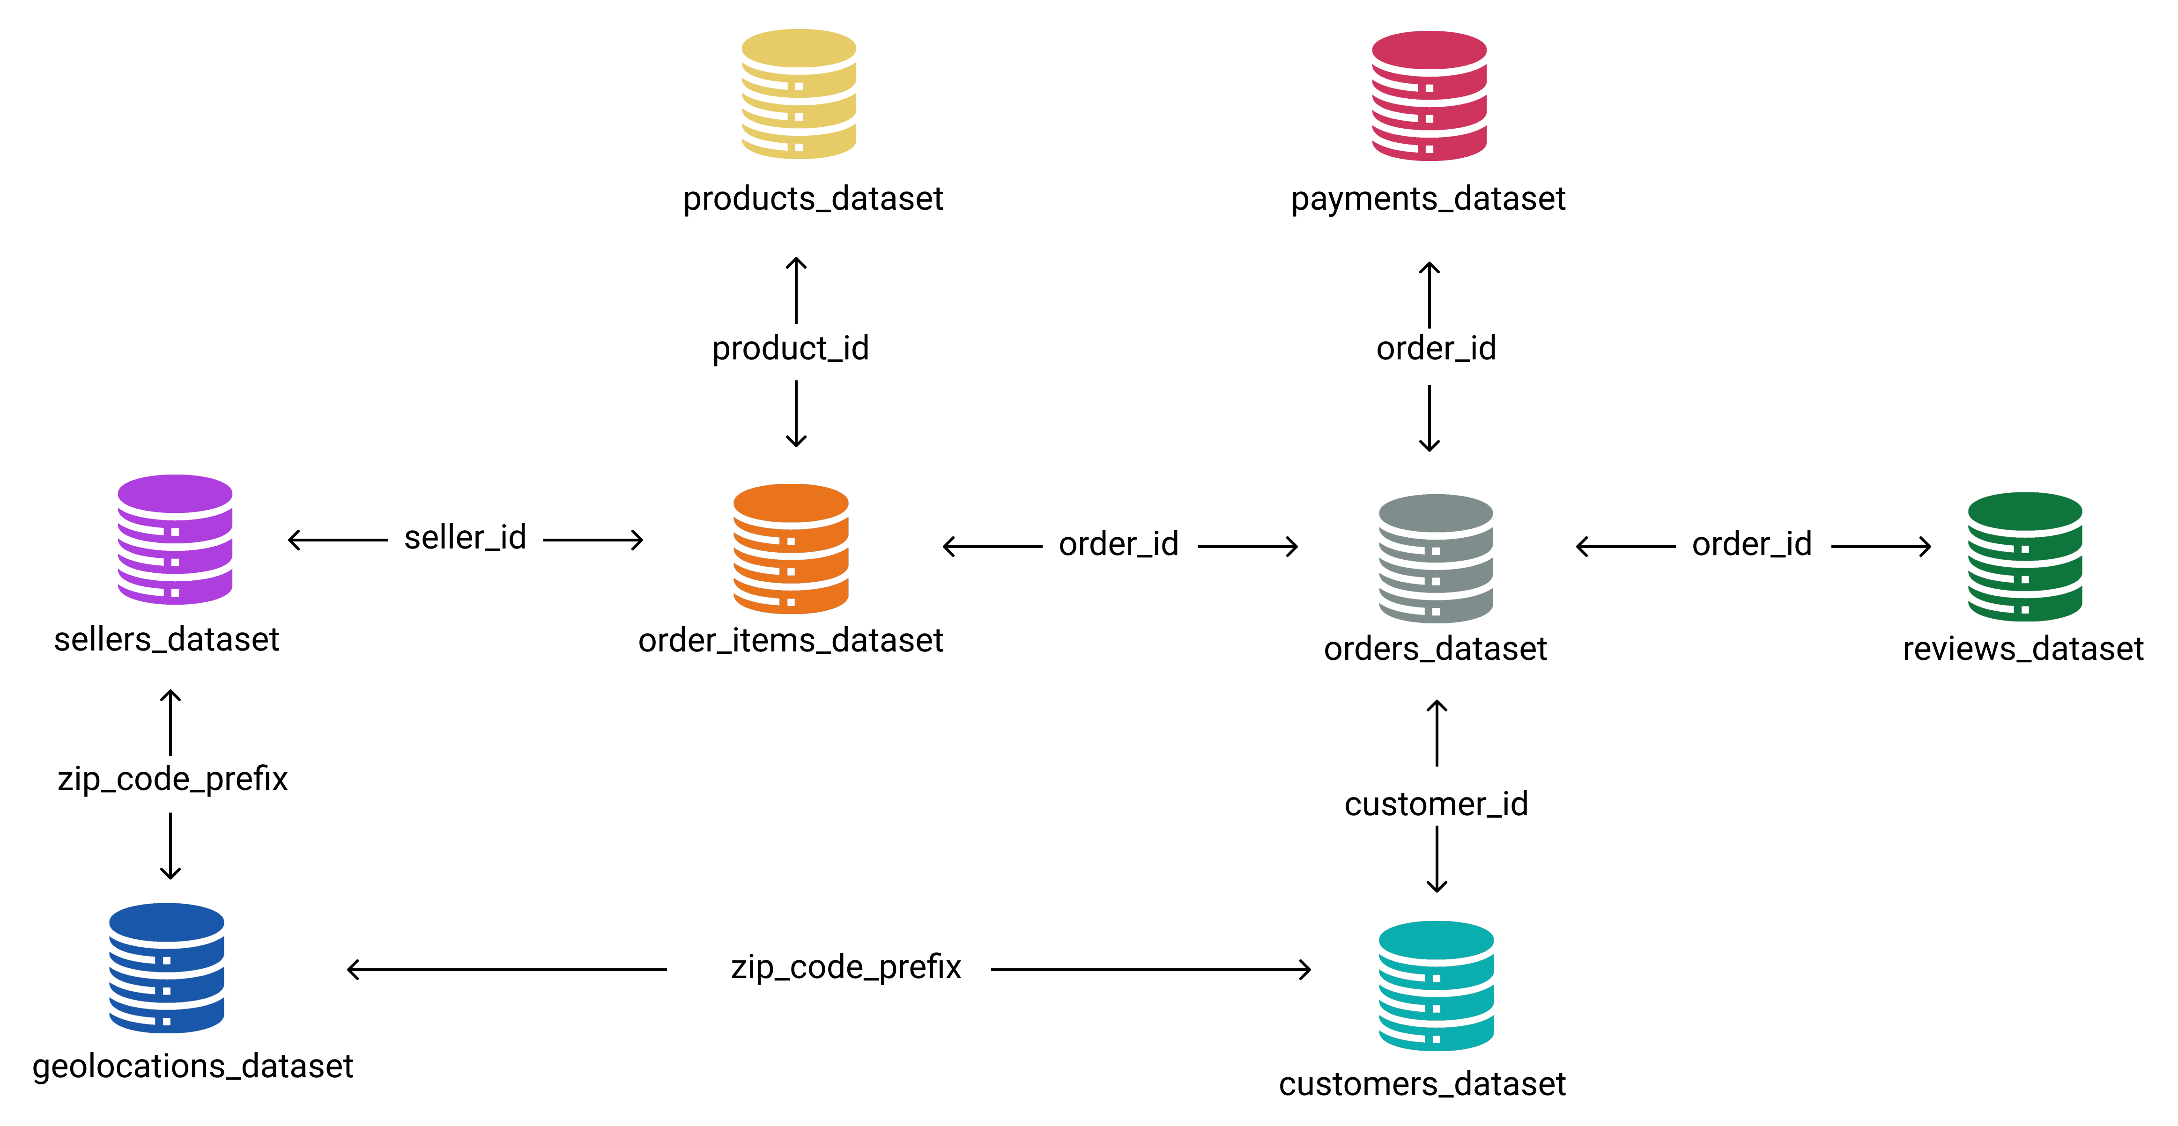
Data Preparation
Before processing the data, the first step that needs to be done is to prepare the raw data so that it becomes structured data and is ready for processing. The datasets used in this project are 8 datasets which have a relationship with one another. Below are the steps for data preparation:
Figure 1. Data Relationship Schema
Create a new database and its tables for the data that has been prepared by paying attention to the data type of each column.
Importing csv data into the database by paying attention to the dataset storage path.
Create entity relationships between tables, based on the schema in Figure 1. Data Relationship.
Then export the Entity Relationship Diagram (ERD) in the form of an image by setting the data type and naming the columns between interconnected tables.
View or Download Schema here

Slide 5
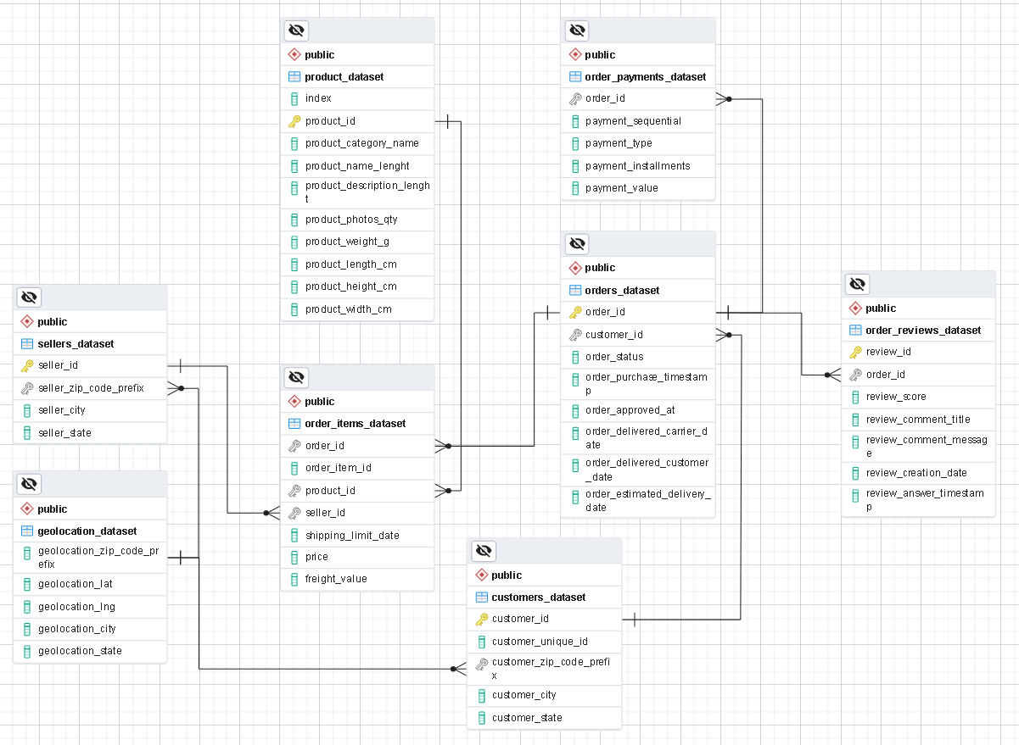
Data Preparation
After making adjustments to the Primary Key (PK) and Foreign Key (FK), the following ERD results are generated as shown in figure 2.
Figure 2. Entity Relationship Diagram (ERD)
View or Download ERD here
The complete query can be seen here

